Slide 1
Software for Social Good
Notes:
Hello my name is Charles LaPierre, I am the Technical Lead for DIAGRAM & Born Accessible. My Colleague is Alex Cabral who is our UI/UX research expert at Benetech.
Benetech is a different kind of tech company. We’re a nonprofit whose mission is to empower communities in need by creating scalable technology solutions.

Slide 2
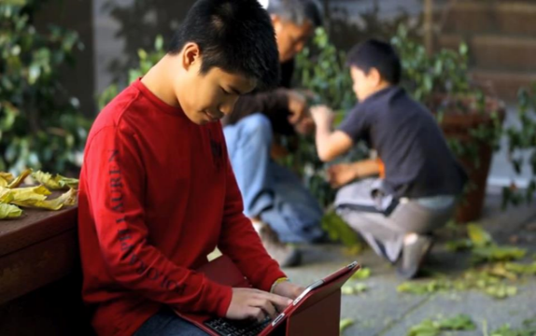
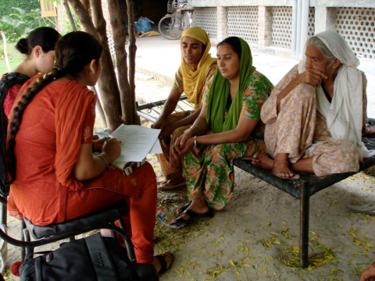
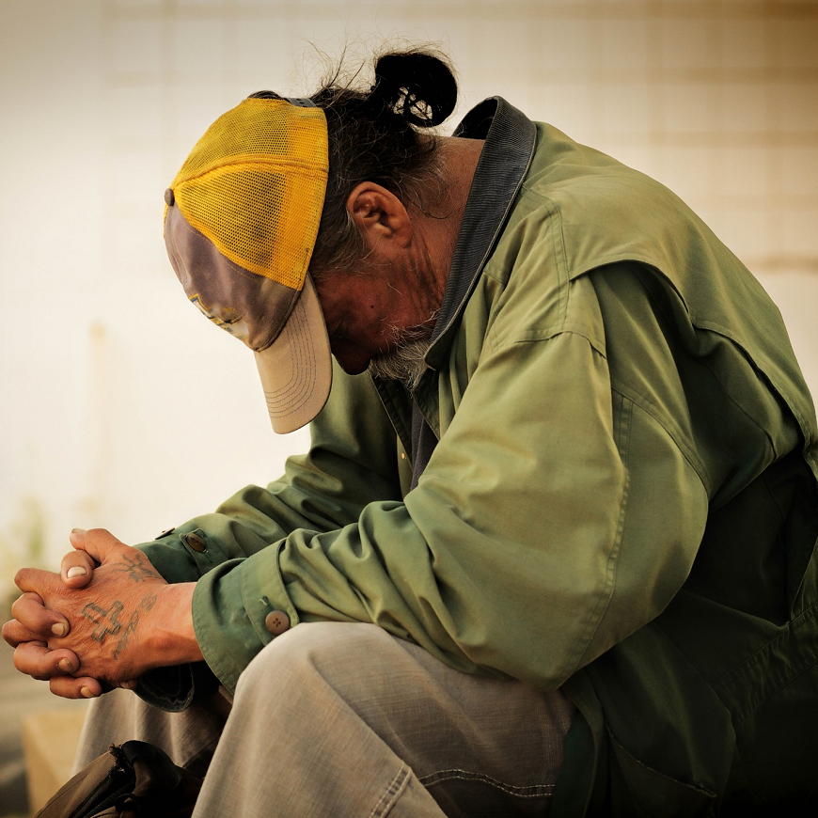
Our work
GLOBAL EDUCATION and LITERACY
HUMAN RIGHTS
We empower communities
with software
for social good
POVERTY ALLEVIATION
Notes:
Our work focuses on global education and literacy, making it safer for human rights defenders in over 50 countries to document and collaborate on human rights violations, and empower those who are struggling to find the resources and services they need to thrive.

Slide 3
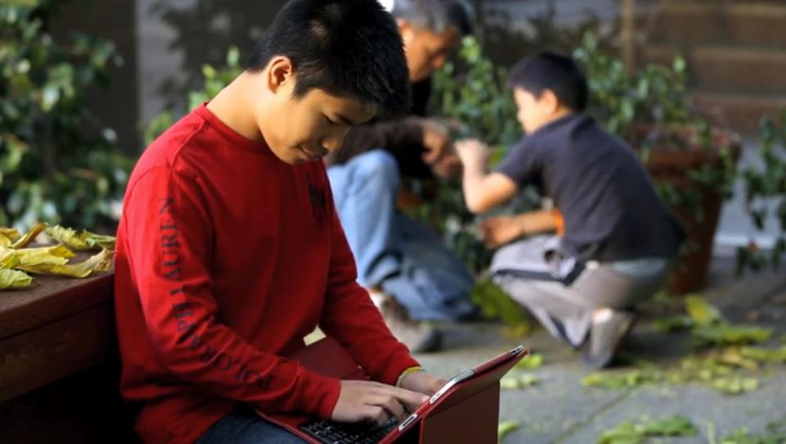
Bridge
We serve as a bridge between the social sector and Silicon Valley to
drive lasting social change
Notes:
Our mission is to leverage technology to help humanity by connecting Silicon Valley technical knowhow with the communities who are in need.

Slide 4
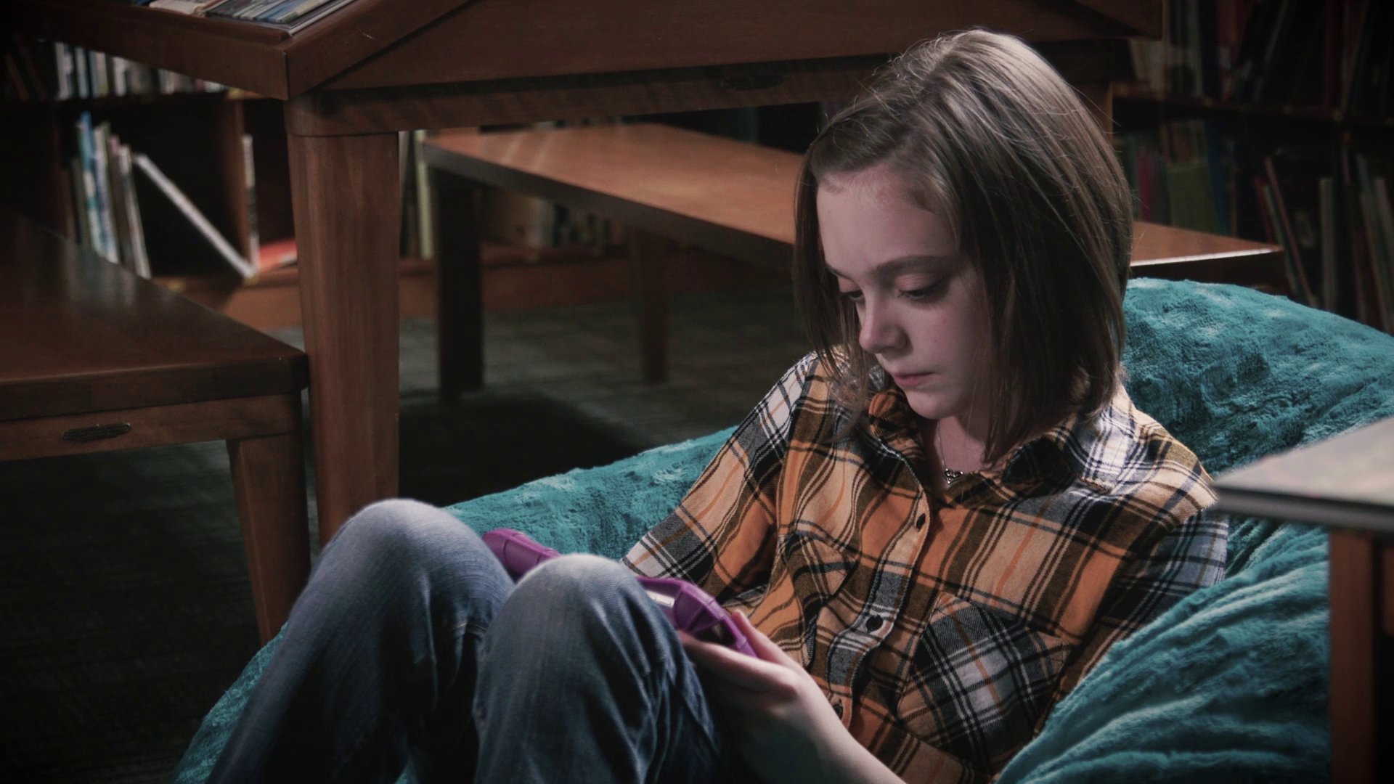

Bookshare Statistics
15 Million+ accessible ebooks delivered
700,000 Bookshare users
780,000+ Books
870 publisher partners
47 languages
Notes:
Bookshare is our flagship success story which is the largest library in the world of accessible books for people with a print disability. Serving over 15 million accessible ebooks, to over 700K users with over 780K books from 870 publishers in 47 languages.

Slide 5
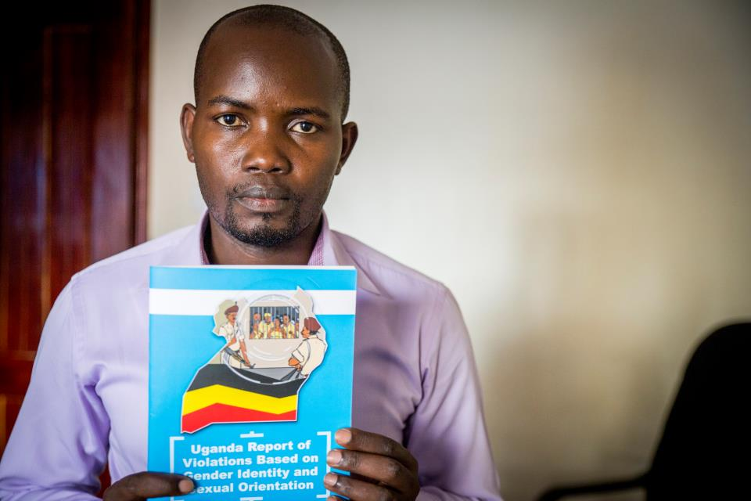
Human Rights
50+ Countries
Thousands of human rights activists securely documented violations
Notes:
Our Human Rights program has made a huge difference in how data is collected securely and now we are focusing on how to privately share and collaborate with video using machine learning.

Slide 6
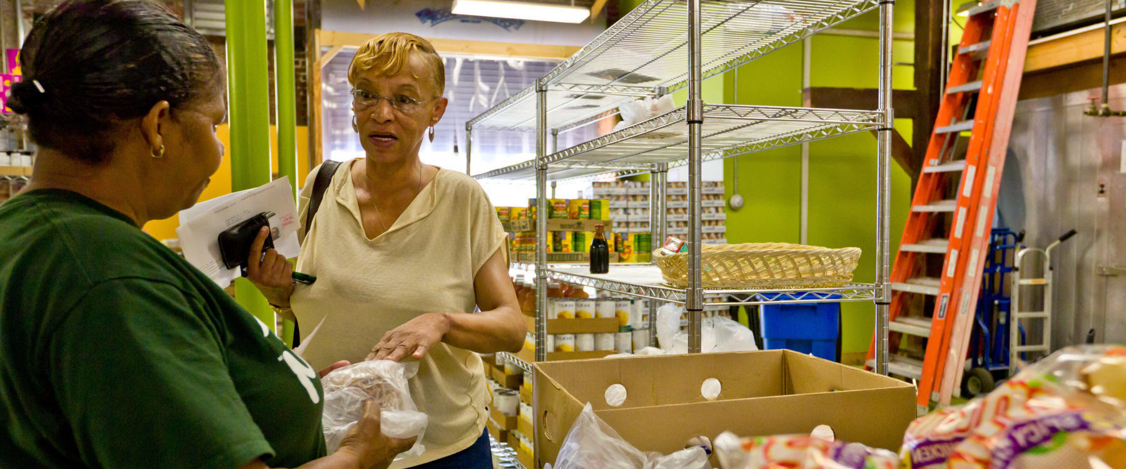
Human Services
1.7 Million
People in the Bay Area with better access to human services*
*Projected
Notes:
ServiceNet and our Data for Inclusion project is helping service providers have access to accurate real-time data about the resources available for their clients.

Slide 7
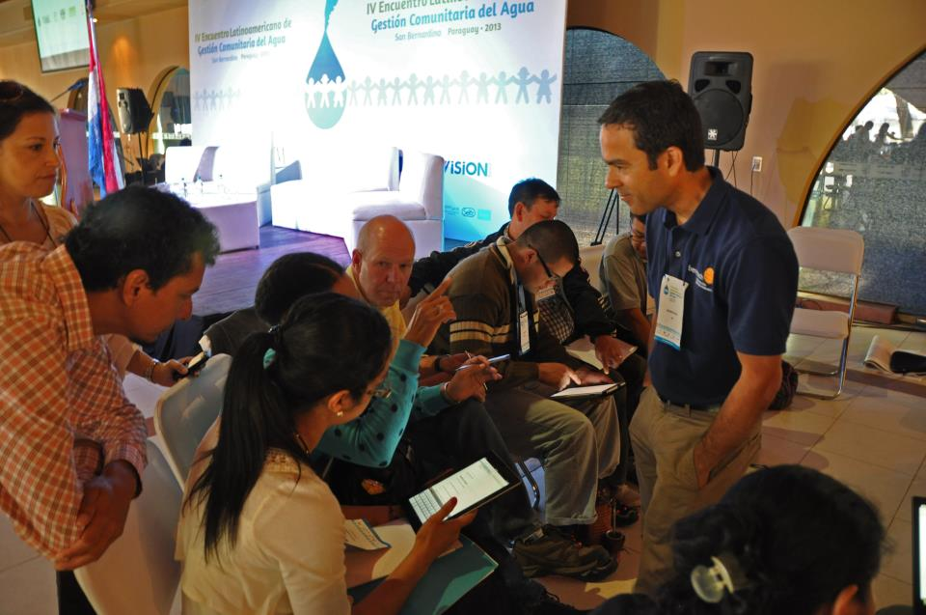
Community Outreach
We advise, build and foster the software for social good ecosystem.
Notes:
We at Benetech advise, build and foster the software which drives a social good ecosystem.

Slide 8

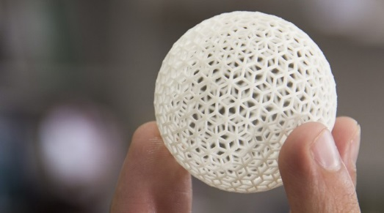

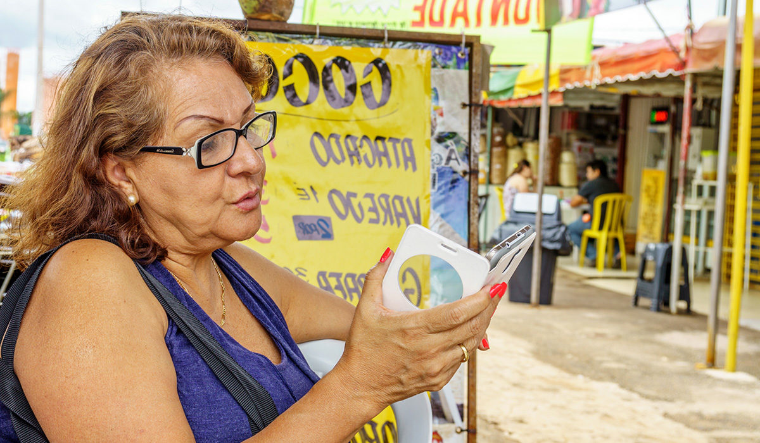
Empowering Inclusive Access to Opportunities with Software
Bookshare: Access to information for those with reading barriers
Members can access a huge collection of ebooks and read their way
DIAGRAM Center: Building new paths to accessibility
A research and development center that creates tools, standards and best practices to support different learning needs.
Benetech Service Net: Strengthening the social safety net
Data exchange platform that allows for more accurate, timely, and cost-effective management of social services resource information.
Data for Inclusion: Giving people with disabilities a voice as they seek employment and education
People with disabilities and disabled persons’ organizations can provide firsthand reports of the issues they face.
Notes:
Bookshare provides a number of alternative formats of the books we have curated allowing the reader to pick the format that works best for them. These include Braille, audio, EPUB, and Microsoft Word.
The DIAGRAM Center works with our communities and standards bodies to improve access to education materials. We do this by new creating tools, standards and best practices to support different learning needs including access to information for those disabilities not traditionally associated with a print disability. Such as those with a cognitive or physical disability.
Service Net helps to eliminate duplicative siloed information that multiple organizations gathered and were often times out of date and inaccurate. By providing a platform where these organizations can trust each other and work together to share their data with each other so as to better serve their communities.
Our Data for Inclusion effort gives people with a disability a voice as they seek employment and education.

Slide 9

Born Accessible
Introduced “Born Accessible” and “Buy Accessible” guidelines
If a book can be born digital, it can be Born Accessible
Now helping to set accessibility
“gold standard” for publishers
Notes:
Born Accessible is near and dear to my heart. Adding accessibility as an afterthought is 10 times more costly than if you build in accessibility initially. We are working with publishers to help improve their production workflow so that the ebook they create is truly Born accessible and no special libraries (like Bookshare) would need to exist to serve the disabled since everyone could buy the book which is accessible. Just like curb-cuts that were built for wheelchair access are used by those pushing strollers, accessible EPUBs can "Read-Aloud" for those who are doing other tasks while reading such as driving.
Benetech also has created a certification program call "Global Certified Accessible" that will stamp those books which pass our certification with a gold stamp that folks can look for to ensure that the book they are purchasing is accessible for them.

Slide 10
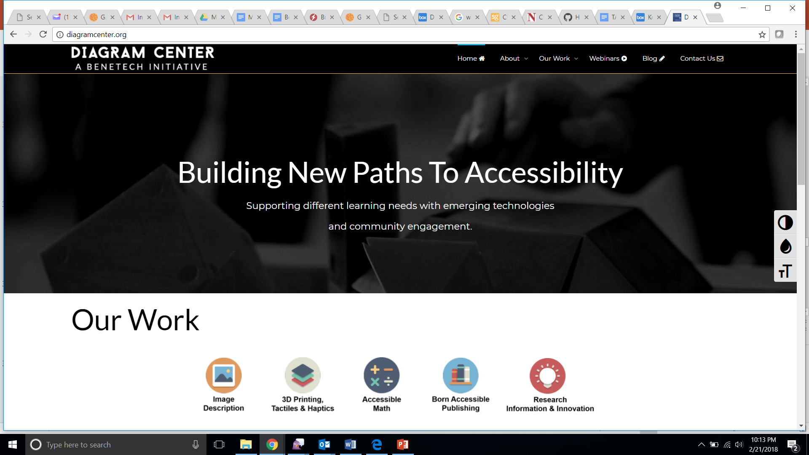
diagramcenter.org
Building tools and best practice examples, establishing new standards, and finding ways to share our resources to make education accessible for all
Notes:
The DIAGRAM Center builds tools, best practices, and improves standards around accessible access to education materials. Some of the projects we have done include and accessible Image and code repositories, creating standards and best practices around making STEM accessible. We create a yearly DIAGRAM Report highlighting new technologies being used in education that can be harnessed to create accessible and born accessible classrooms.

Slide 11
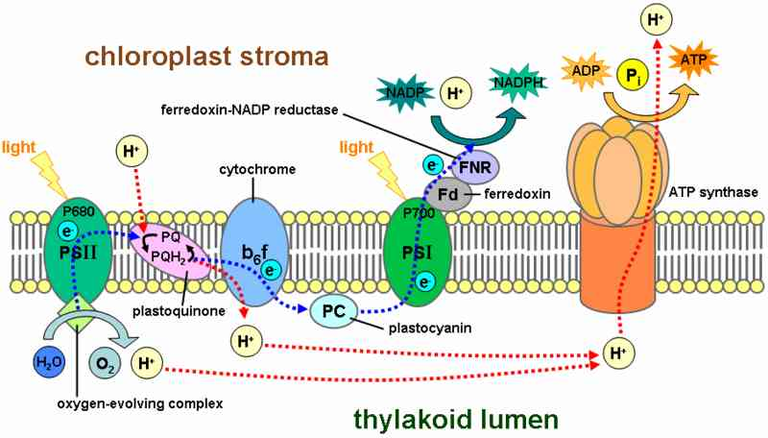
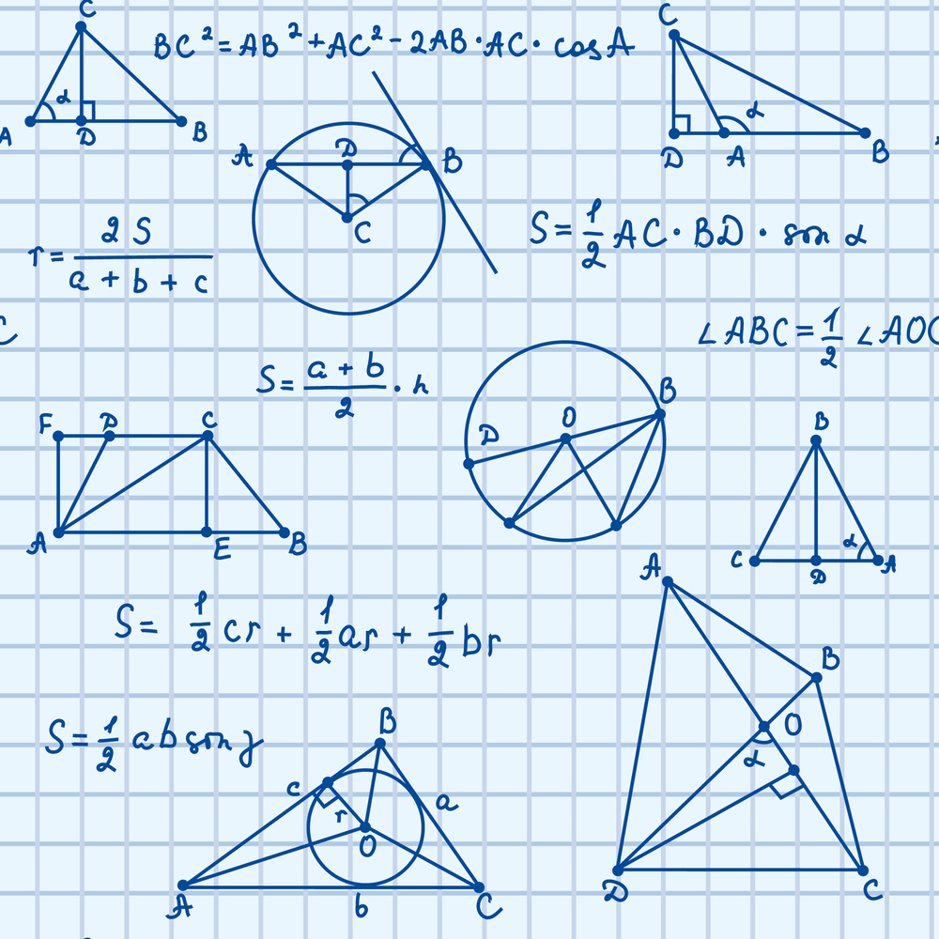
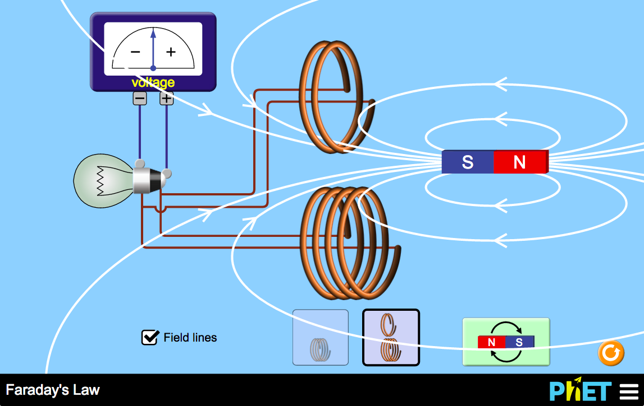
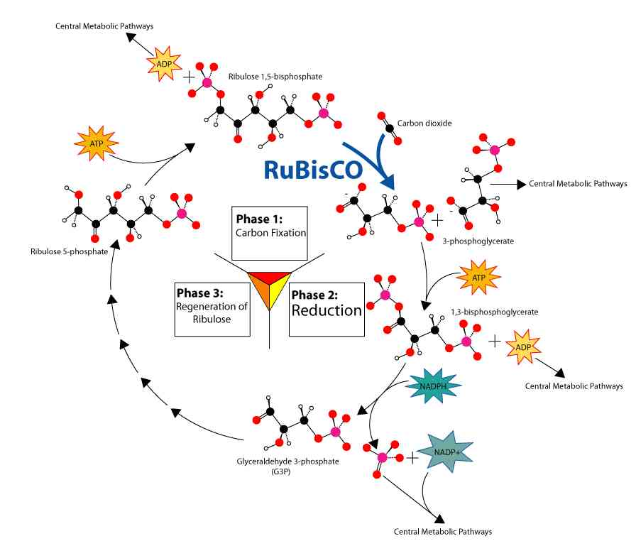
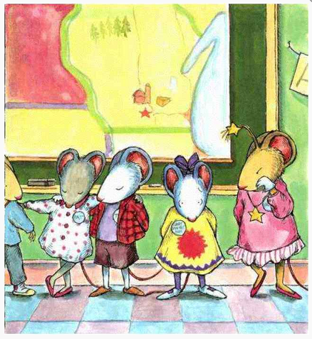
Making STEM Accessible for All Learners
Notes:
So much complexity and variety when it comes to educational content
Images, diagrams, videos – lots of content on the web; hard to locate desired content (standardized metadata for search)
Math diagrams & equations – content involving specialized markup is a problem for all learners in the digital world
Videos, interactives, VR, and more – requires advanced technology infrastructure & tools
3D technology & alternatives for teaching – UDL & need to cater to different learning styles

Slide 12

Labs
Notes:
Benetech Labs is our new product development arm, where we explore new areas of need by engaging with communities, other technologists, and non-profits in the ecosystem around an issue to prototype new solutions. We experiment to find effective tech solutions that Benetech can take to scale and achieve large, lasting social impact

Slide 13

Inclusive Math
Up to 35% students struggle with math
4-14% identified learning disability in mathematics*
Notes:
https://council-for-learning-disabilities.org/wp-content/uploads/2014/12/Math_Disabilities_Support.pdf
4-8% + 2.7
Math is hard enough to learn, now imagine not being able to see the math equation and your only access to the math is a description spoken to you. I don't know about you but for complex algebra and calculus by the time you read the entire equation I would have forgotten more than half of the equation. Now add on other disabilities like dyslexia, dyscalculia, or dysgraphia to the mix and you quickly understand we need to have a better solution.

Slide 14
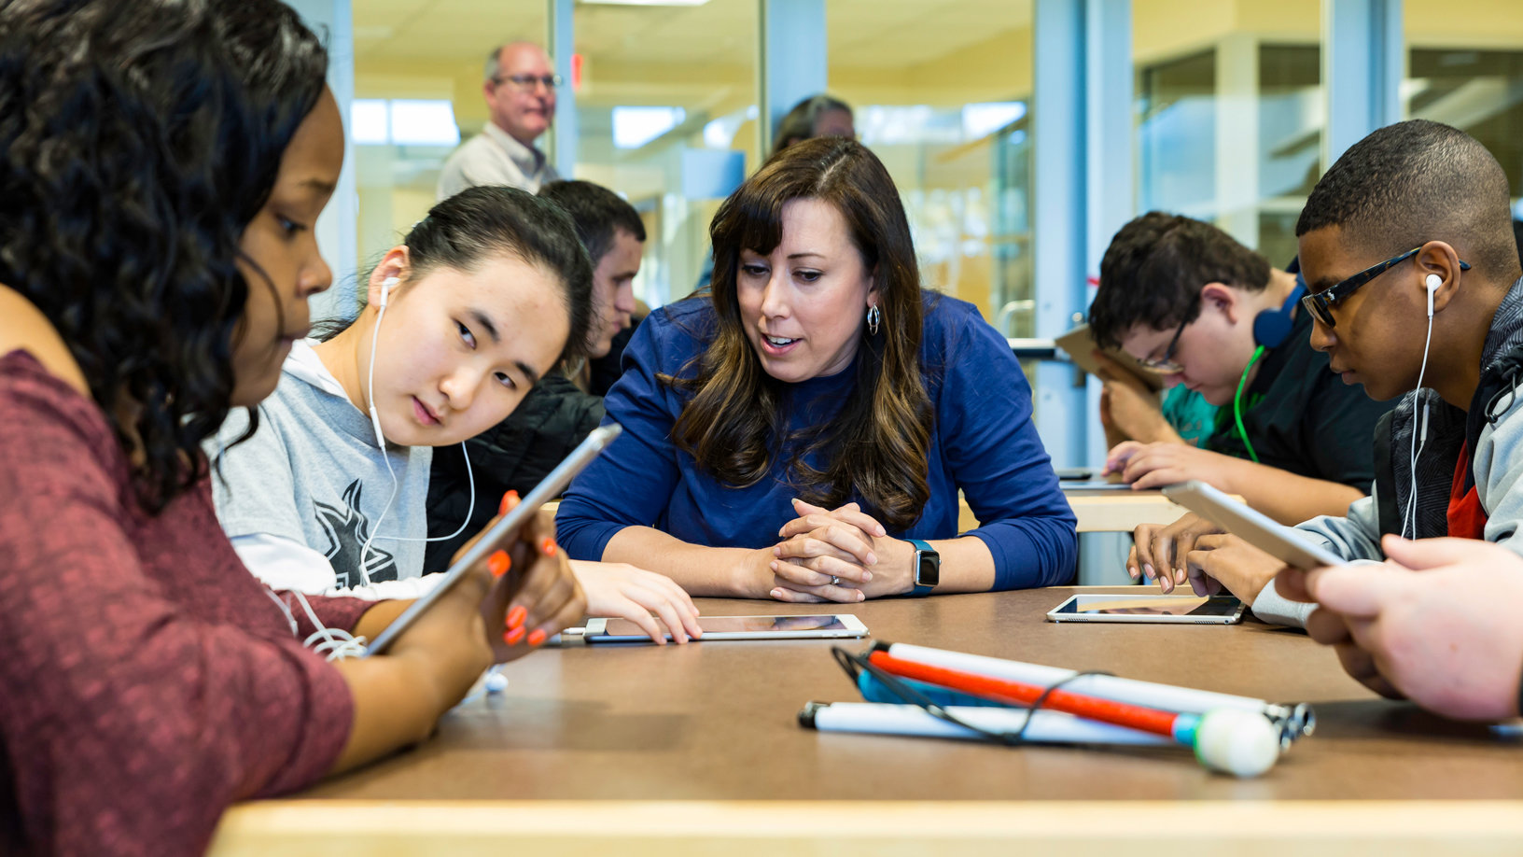
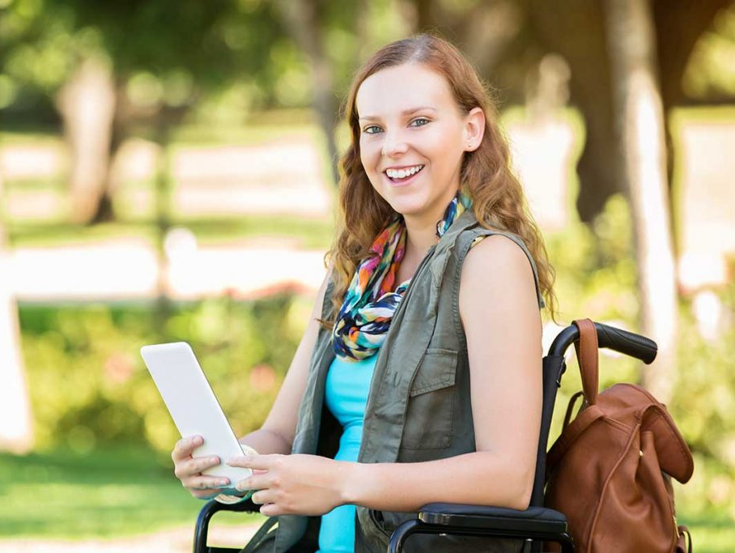
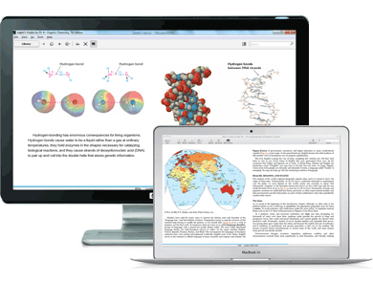
Bentech Mathshare
An inclusive tool that helps students show, share and organize their work
Helping teachers work one on one with students in a blended and inclusive classroom
Students working independently at home, on the bus, or at school
Embedded within existing and new digital curriculum
Notes:
As more and classes are moving digital the need for an inclusive accessible math solution is required. Mathshare will give the students their independence while providing the feedback needed to the teacher to help them better understand what the student knows and where they need to focus more on.

Slide 15
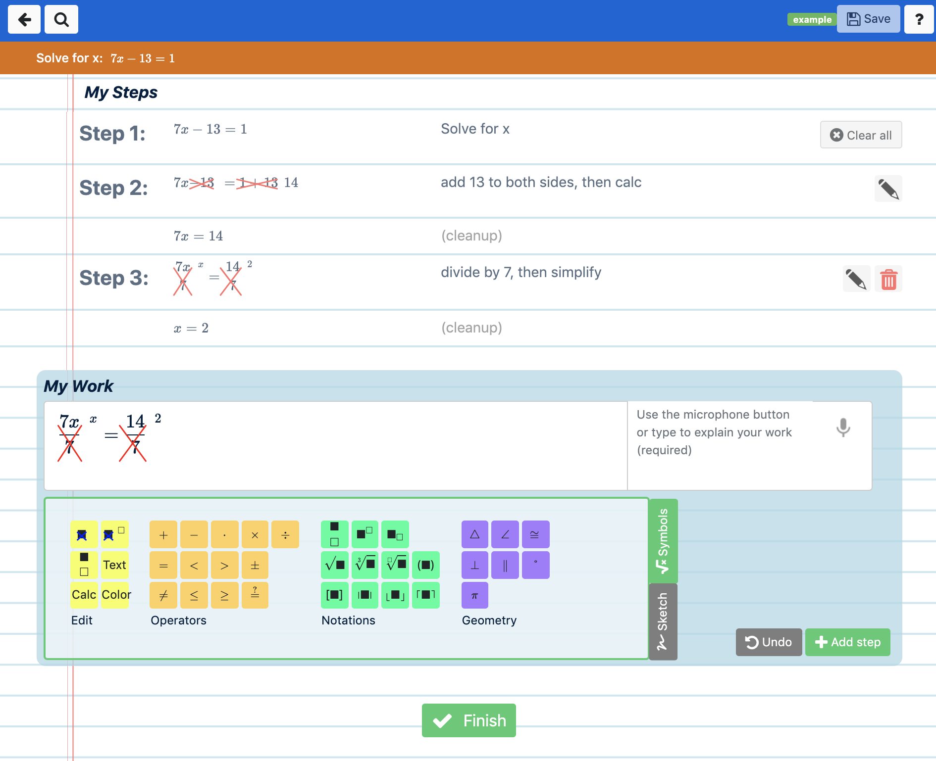
Mathshare
Notes:
Here is a screen shot of our Mathshare project where you have three areas of interest.
Math solution space including the steps taken
Notes area describing each step
Input area including dedicated buttons, symbols, operators etc.

Slide 16
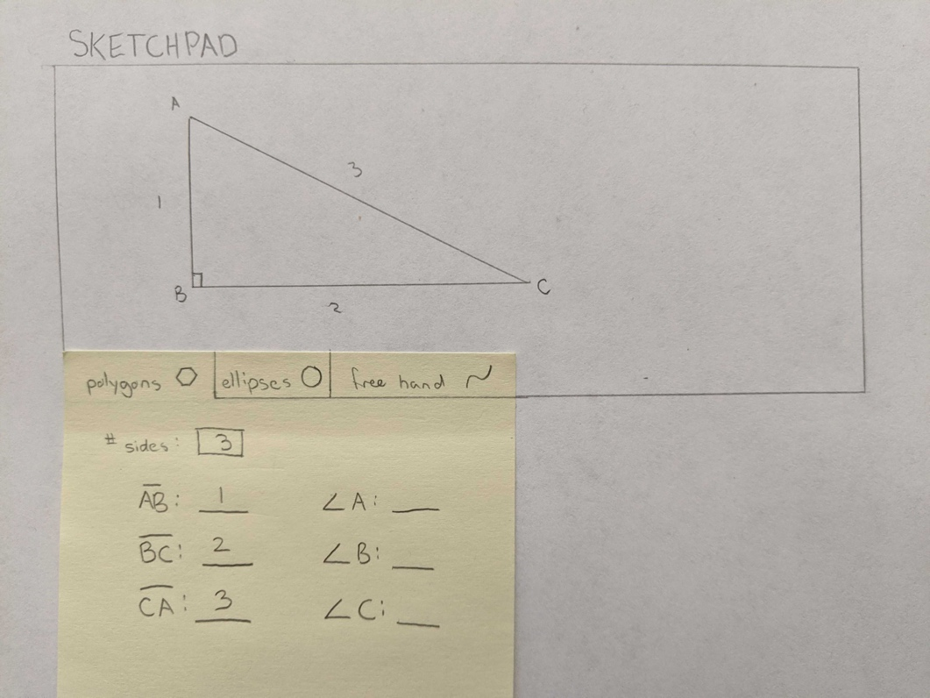
Hackathon IDEA: Accessible Math Sketchpad
GitHub: https://tinyurl.com/ugptajd
Challenge: Create a web-based Accessible Sketchpad that will draw basic geometric shapes based on users input and done in such a way that students can explore the image created in an accessible way!
Notes:
The first is an accessible Sketchpad for Mathshare that will be used to create labelled accessible shapes. Project information can be found at tinyurl.com/ugptajd

Slide 17
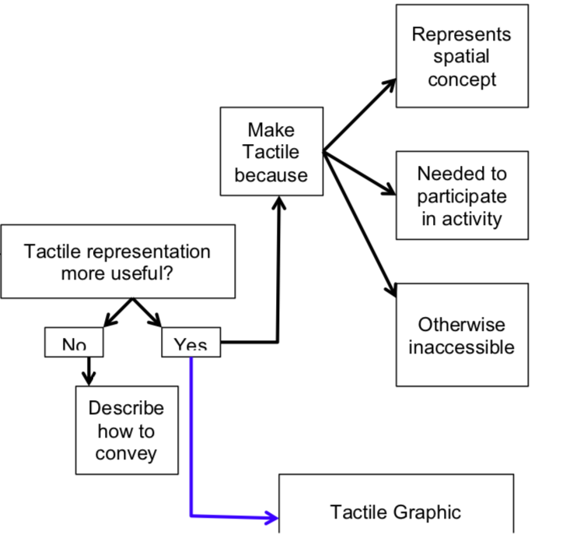
Hackathon IDEA: Accessible Survey Logic
GitHub: https://tinyurl.com/rd6wwbl
Complex surveys that use branching logic based on the answer of a previous question are inaccessible to users that require assistive technology. We need an assessible option!
Notes:
Project idea 2 is an Accessible Survey Logic that will help us create surveys that will ask you different questions based on previous answers which

